Slide 1
DETECTING PATTERNS IN SUICIDAL IDEATION ON REDDIT
YASHWANTEJ DYAVARI SHETTY

Slide 2
CONTENTS
Introduction
Research objective
Data collection
Data preprocessing
Progression between subreddits
Changes in user behaviour over time
Sentiment analysis
Topic modelling
LIMITATIONS
CONCLUSION

Slide 3

INTRODUCTION
Social media has become another venue for those struggling with thoughts of suicide.
With the increase in popularity of social media, many individuals turn to social media looking for peer support with mental health conditions such as depression and suicide . This presents an opportunity for early detection or intervention on social media platforms when this behavior is observed.
In our study we seek to better understand patterns in these users' behaviors, particularly on the Reddit social media platform. This study will explore how Reddit users move or progress between subreddits until they express active suicidal ideation

Slide 4

Research Objective
The objective of this research is to analyze suicidal ideation on Reddit using Natural Language Processing. By examining the language patterns in posts and comments, we aim to understand the underlying emotions, themes, and potential warning signs associated with suicidal thoughts. This analysis can contribute to the development of effective preventive measures and support systems for individuals in distress.

Slide 5

Data Collection
In order to conduct this analysis, a dataset of Reddit posts and comments related to suicidal ideation was collected. The dataset includes anonymized text data from various subreddits where individuals discuss their thoughts and experiences. The collected data covers a wide range of demographics, providing a diverse perspective on the topic.

Slide 6

Data Preprocessing
Before analyzing the data, several preprocessing steps were performed. These include removing irrelevant information, such as URLs and usernames, as well as standardizing the text by converting to lowercase and removing punctuation. Additionally, stop words and common words were ﬁltered out to focus on meaningful content for analysis.

Slide 7
PROGRESSION BETWEEN SUBREDDITS
The main objective of studying Progression Between Subreddits was to determine whether users who express suicidal ideation on the SuicideWatch subreddit typically start their online journey in other subreddits, such as those related to depression, and then gradually move towards expressing suicidal thoughts.
Understanding this progression is crucial because it can provide insights into the stages of emotional distress that users go through before they reach a point of expressing suicidal thoughts

Slide 8
CHANGES IN USER BEHAVIOUR OVER TIME
Changes in User Behavior Over Time in the study investigate how Reddit users' posting
patterns and sentiments evolve as they approach and experience their first expression of suicidal ideation.
This analysis provides valuable insights into the emotional trajectories of individuals in distress, aiding in the
development of targeted interventions and support mechanisms.

Slide 9
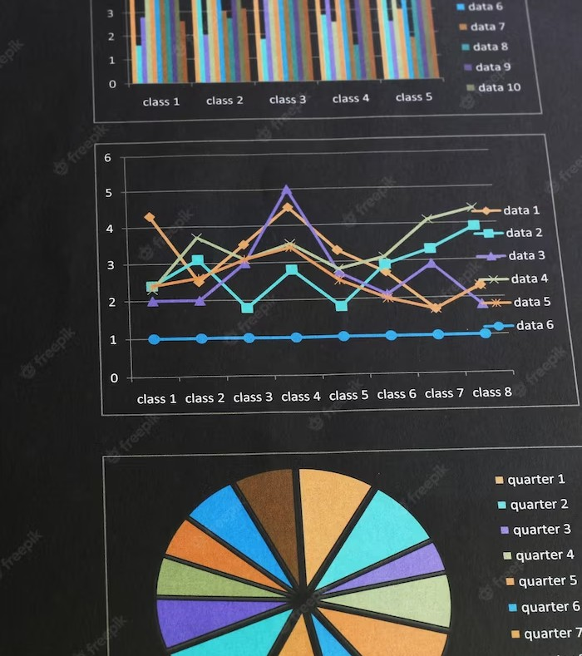
Sentiment Analysis
Sentiment analysis is a key aspect of this study. By applying Natural Language Processing techniques, we can determine the sentiment expressed in the text, whether it is positive, negative, or neutral. This analysis helps us understand the emotional state of individuals discussing suicidal ideation and identify potential risk factors.

Slide 10

Topic Modeling
Topic modeling is utilized to uncover the themes present in the Reddit posts. By employing techniques such as Latent Dirichlet Allocation (LDA), we can identify the underlying topics discussed, such as depression, loneliness, or self-harm. This analysis enables us to gain a deeper understanding of the issues surrounding suicidal ideation.

Slide 11

Emotion Analysis
Emotion analysis is crucial in understanding the emotional context of suicidal ideation. By leveraging Natural Language Processing algorithms, we can identify emotions expressed in the text, such as sadness, hopelessness, or anger. This analysis provides insights into the emotional struggles individuals face, aiding in the development of effective interventions.

Slide 12

Risk Factor Identiﬁcation
Through the analysis of language patterns, we can identify potential risk factors associated with suicidal ideation. Certain words, phrases, or topics may indicate higher risk levels.
By understanding these factors, we can develop targeted interventions and support systems to assist
individuals in crisis and reduce the likelihood of self-harm.

Slide 13

Temporal Patterns
Temporal patterns analysis helps us understand the ﬂuctuations in suicidal ideation over time.
By examining the frequency and intensity of
posts during speciﬁc periods, we can identify temporal patterns, such as higher activity during holidays or certain times of the year. This knowledge can aid in allocating resources and providing timely support.

Slide 14
LIMITATIONS:
The analysis is based solely on text data, limiting the understanding of non-verbal cues and individual contexts.
Additionally, the dataset represents a speciﬁc online community and may not be generalizable to the entire population. These limitations should be considered when interpreting the ﬁndings.
The users may not always express genuine thoughts and feelings. Some users might post for attention or as a form of fiction, which can affect the accuracy of the data.
Reddit and its user behavior may evolve over time, potentially impacting the relevance and applicability of the study's findings to the present day.

Slide 15

Future Scope
Further studies can incorporate multimodal data, including images and audio, to gain a more comprehensive understanding of suicidal ideation. Additionally, exploring the effectiveness of different interventions and support systems can contribute to the development of targeted strategies for suicide prevention.

Slide 16
IMPLICATIONS:
The ﬁndings of this study have several implications for mental health professionals, policymakers, and online communities.
Understanding the patterns and risk factors associated with suicidal ideation can aid in the early identiﬁcation of individuals at risk and the development of proactive interventions. It also emphasizes the importance of fostering supportive online environments to provide help and resources to those in need.

Slide 17
Key Takeaways:
The analysis of suicidal ideation on Reddit through Natural Language Processing provides valuable insights into the emotional state, themes, and risk factors associated with suicidal thoughts. By leveraging these ﬁndings, we can develop targeted interventions, allocate resources effectively, and foster supportive communities to prevent suicide and provide timely support to individuals in distress.

Slide 18
Conclusion
By examining language patterns, sentiment, topics, and risk factors, we can gain valuable insights into the emotional struggles individuals face. This knowledge can contribute to the development of effective interventions, support systems, and preventive measures. Let's work together to create a world where everyone feels supported and valued.

